Slide 1
Lecture-10

Slide 2
Contents
DevOps Automation
DevOps Utility
CI / CD

Slide 3
DevOps Automation
DevOps automation is the practice of automating repetitive and manual DevOps tasks to be carried out without any human interaction. Automation can be applied throughout the DevOps lifecycle, spanning:
  Design and development
  Software deployment and release
  Monitoring

Slide 4
DevOps Automation Benefits
Fosters speed
Greater accuracy
Consistency
Reliability
Increases the number of deliveries
Ultimately, automation in DevOps encapsulates everything right from building, deploying and monitoring.

Slide 5
DevOps Automation Tools
DevOps team that maintain extensive massive IT infrastructure can be classified into six categories.
  Infrastructure Automation
  Configuration Management
  Deployment Automation
  Performance Management
  Log management
  Monitoring

Slide 6
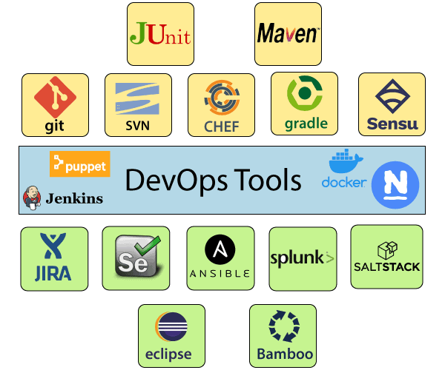
DevOps Automation Tools
Some most popular DevOps tools

Slide 7
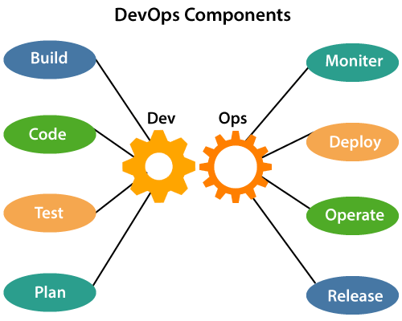
DevOps Automation Tools (Cont.)
DevOps Tools

Slide 8
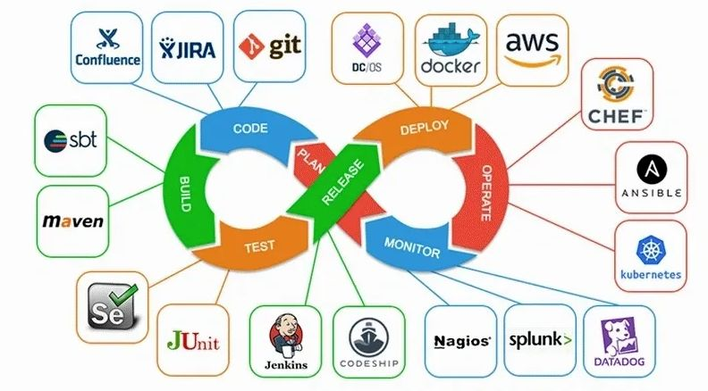
DevOps Automation Tools Architecture (Cont.)
DevOps Tools

Slide 9
Infrastructure Automation
Amazon Web Services (AWS): Being a cloud service, you don't need to be physically present in the data center, they are easy to scale on-demand, and there are no up-front hardware costs. It can be configured to provide more servers based on traffic automatically.

Slide 10
Configuration Management
Chef:
  It is a handy DevOps tool for achieving speed, scale, and consistency.
  It can be used to ease out of complex tasks and perform configuration management.
  The chef is used in infrastructure automation and helps in reducing manual and repetitive tasks for infrastructure management.
  With the help of chef, the DevOps team can avoid making changes across ten thousand servers. Rather, they need to make changes in one place, which is automatically reflected in other servers.

Slide 11
Configuration Management (Cont.)
Puppet:
  Puppet is the most widely used DevOps tool.
  It allows the delivery and release of the technology changes quickly and frequently.
  It has features of versioning, automated testing, and continuous delivery.
  It enables to manage entire infrastructure as code without expanding the size of the team.

Slide 12
Configuration Management (Cont.)
Ansible:
  Ansible is an open-source IT engine that automates application deployment, cloud provisioning, intra service orchestration, and other IT tools.
  It can be used to ease out of complex tasks and perform configuration management.
  Ansible is easy to deploy because it does not use any agents or custom security infrastructure on the client-side, and by pushing modules to the clients. These modules are executed locally on the client-side, and the output is pushed back to the Ansible server.
  Ansible uses the playbook to describe automation jobs, and playbook, which uses simple language, i.e., YAML. YAML is a human-readable data serialization language & commonly used for configuration files, but it can be used in many applications where data is being stored.

Slide 13
Configuration Management (Cont.)
Saltstack:
  Ansible is an open-source IT engine that automates application deployment, cloud provisioning, intra service orchestration, and other IT tools.
  Stackify is a lightweight DevOps tool. It shows real-time error queries, logs, and more directly into the workstation. SALTSTACK is an ideal solution for intelligent orchestration for the software-defined data center.

Slide 14
Deployment Automation
Jenkins
  It facilitates continuous integration and testing.
  It helps to integrate project changes more efficiently by quickly finding issues as soon as built is deployed.

Slide 15
Performance Management
App Dynamic
  It offers real-time performance monitoring.
  The data collected by this tool help developers to debug when issues occur.

Slide 16
Log Management
Splunk
  This DevOps tool solves issues such as storing, aggregating, and analyzing all logs in one place.

Slide 17
Monitoring
Nagios
  It notified people when infrastructure and related service go down. Nagios is a tool for this purpose, which helps the DevOps team to find and correct problems.

Slide 18
Code Version Control
Git
  it is an open-source distributed version control system DevOps tool

Slide 19
Testing Suite
Selenium
  It is one of the most widely used open source Web UI (User Interface) automation testing suite.
JIRA
  It is a software testing tool developed by the Australian Company Atlassian. It is a bug tracking tool that reports all the issues related to your software or mobile apps.

Slide 20
Code build
Maven
  It is a powerful project management tool that is based on POM (project object model). It is used for projects build, dependency and documentation.
  It simplifies the build process like ANT. But it is too much advanced than ANT.

Slide 21
DevOps Collaboration
DevOps enables continuous communication between cross-functional and autonomous teams. Also, DevOps advocates for getting customer feedback early on during sprints to help inform expectations, thus guiding developers on what features to focus on to minimize revisions.
This principle also promotes end-to-end responsibility by ensuring that each DevOps architect knows their role and works toward supporting efficient implementations across the entire DevOps pipeline.

Slide 22
CI / CD

Slide 23
CI / CD
CI/CD
The main concepts attributed to CI/CD are Continuous Integration, Continuous Delivery, And Continuous Deployment.
It is a method to frequently deliver apps to customers by introducing automation into the stages of app development.

Slide 24
Continuous Integration
Continuous integration is a DevOps software development practice where developers regularly merge their code changes into a central repository, after which automated builds and tests are run.
Continuous integration most often refers to the build or integration stage of the software release process and entails both an automation component (e.g. a CI or build service) and a cultural component (e.g. learning to integrate frequently).
The key goals of continuous integration are to find and address bugs quicker, improve software quality, and reduce the time it takes to validate and release new software updates.

Slide 25
Continuous Delivery
Continuous delivery is a software development practice where code changes are automatically prepared for a release to production.
A pillar of modern application development, continuous delivery expands upon continuous integration by deploying all code changes to a testing environment and/or a production environment after the build stage. When properly implemented, developers will always have a deployment-ready build artifact that has passed through a standardized test process.

Slide 26
How does Continuous Integration Work?
With continuous integration, developers frequently commit to a shared repository using a version control system such as Git. Prior to each commit, developers may choose to run local unit tests on their code as an extra verification layer before integrating. A continuous integration service automatically builds and runs unit tests on the new code changes to immediately surface any errors.

Slide 27
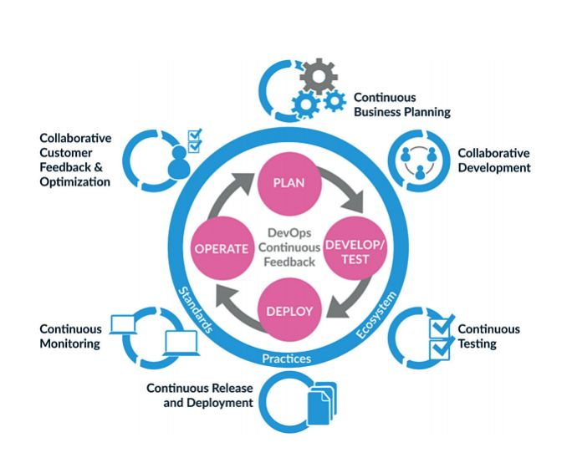
Continuous Workflow (Cont.)

Slide 28
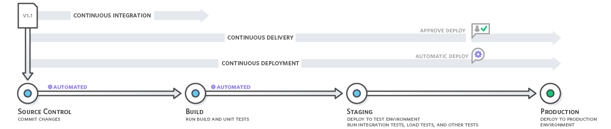
Continuous Workflow (Cont.)

Slide 29
Infrastructure as Code

Slide 30
Infrastructure as Code (IaC)
Infrastructure as Code (IaC) is an approach to managing data center server, storage, and networking infrastructure. IaC is meant to significantly simplify large-scale configuration and management.
With IaC, infrastructure configuration information is housed in standardized files, which can be read by software that maintains the state of the infrastructure.

Slide 31
How does Infrastructure as Code work?
Infrastructure automation becomes possible thanks to template files that are human and machine readable.
These YAML/JSON template files contain instructions for underlying tool on how to manage and provision cloud or server (or both) resources.

Slide 32
Infrastructure as code benefits
Improved productivity:
  Administrators and operators no longer must perform manual configuration steps for data center infrastructure changes.
Improved reliability:
  The configuration of the infrastructure is contained in electronic files, and software is responsible for initiating infrastructure changes, so there is less chance of human error.

Slide 33
Tools for Infrastructure as Code
Some IaC tools publicly available are:

Slide 34
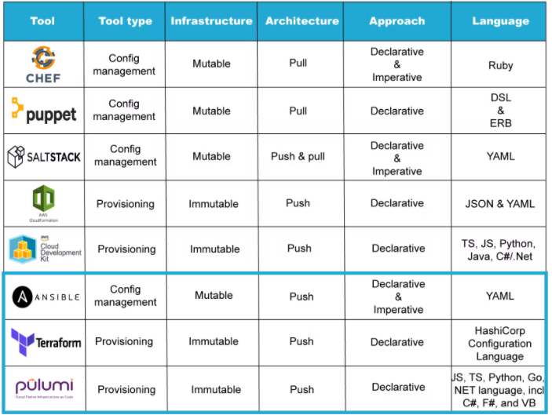

Slide 35
Configurations Management Tools types
A declarative or Push base approach:
  Push bases Configuration server pushes configuration code to nodes (i.e. Ansible)
An imperative or Pull base approach:
  Pull configuration Node checks with the server periodically and fetchs code from the server if there is any update available. (i.e. Chef, Puppet )

Slide 36
Source References
Infrastructure as Code
  https://www.bmc.com/blogs/infrastructure-as-code/
  https://alpacked.io/blog/infrastructure-as-code-for-devops/
  https://www.netapp.com/devops-solutions/what-is-infrastructure-as-code-iac/

Slide 37
Thanks
…?

